Slide 1

Array Programming in C
Studying C Coding from Embedded System Perspective

Slide 2
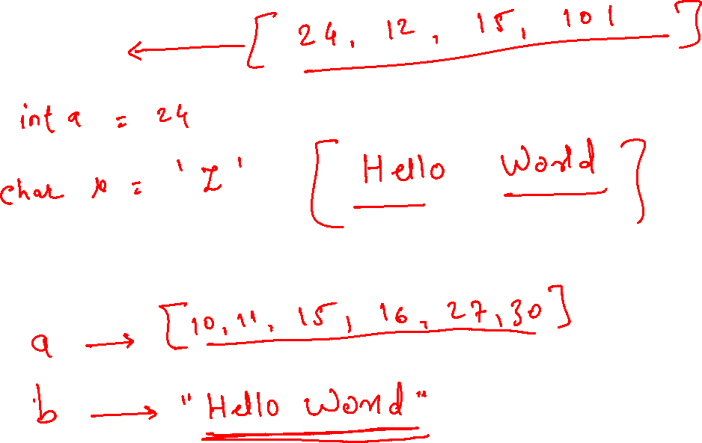
Array

Slide 3
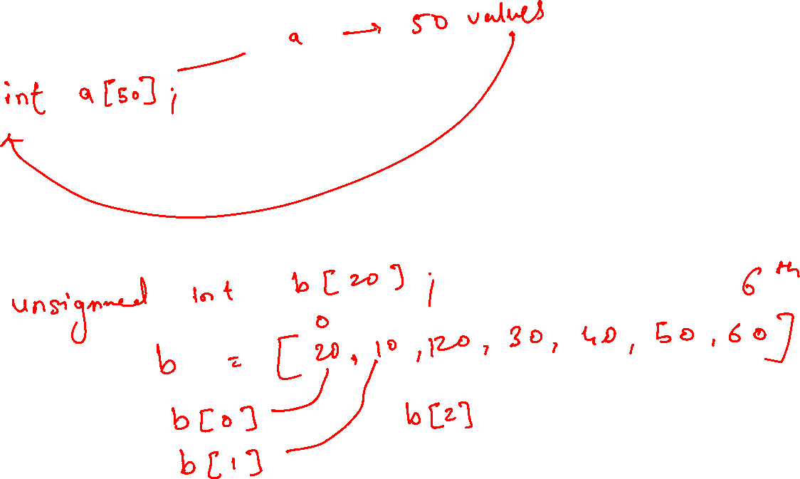

Slide 4
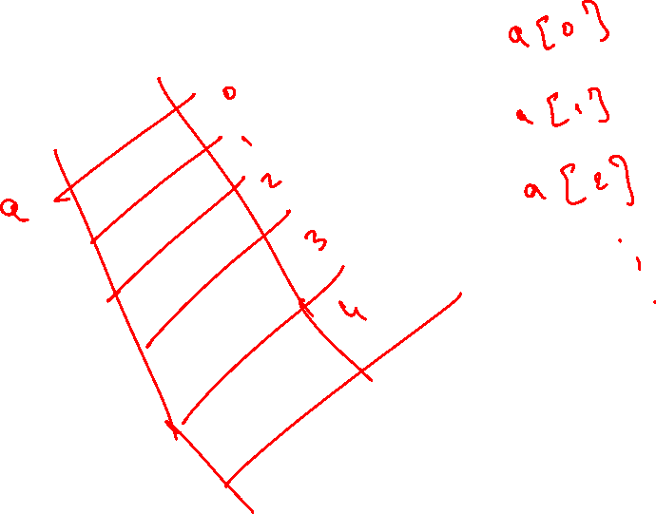

Slide 5

Character Array in C
Strings and Char operations for embedded systems

Slide 6
Char
Every printable character is represented by its ASCII Code
01
ASCII code is max 7 bit long
02
unsigned or signed char can be used
03
An array of char variables is also called string
04

Slide 7

Printing a char
%c can be used with printf to print a single char
putchar can be used to print a single char
%s can be used with printf to print a string
Puts can be used to print a string

Slide 8

How char is scanned
When we scan a char using %c directive, then the decimal equivalent of the character that you entered is saved in the variable
When you print it using %c directive, then the decimal number is “AS IS” sent to print buffer, and since it resemebles an actual ascii code of a letter, the letter is printed.

Slide 9
Scan ( input a char)
Single char can be input with scanf function using %c
single char can be input with getchar function
String can be input with scanf function using %s
String can be input with gets function
None of scnaf / printf / getchar / gets / puts / putchar functions are available in Embedded Systems

Slide 10
Character Comparison
char my = ‘a’
if(my == ‘a’)
{
}

Slide 11
String Comparison
char a[10] = “welcome”
if(strcmp(a, “welcome”) == 0)
{
}

Slide 12
String Functions in C ( also available in all embedded systems)
Sr.No. | Function & Purpose
1 | strcpy(s1, s2); Copies string s2 into string s1.
2 | strcat(s1, s2); Concatenates string s2 onto the end of string s1.
3 | strlen(s1); Returns the length of string s1.
4 | strcmp(s1, s2); Returns 0 if s1 and s2 are the same; less than 0 if s1<s2; greater than 0 if s1>s2.
5 | strchr(s1, ch); Returns a pointer to the first occurrence of character ch in string s1.
6 | strstr(s1, s2); Returns a pointer to the first occurrence of string s2 in string s1.

Slide 13
sprintf
Convert float/int to string in Embedded C

Slide 14
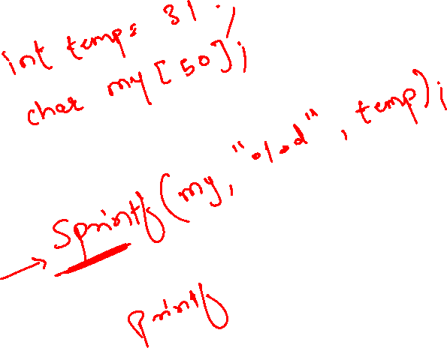

Slide 15
Pointers in C
Very important for Embedded Systems

Slide 16
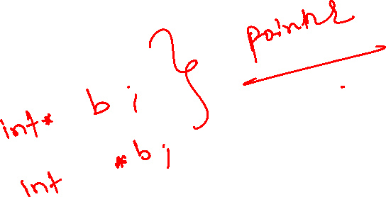
Pointer Syntax in Declaration
int *a;
int *p;

Slide 17
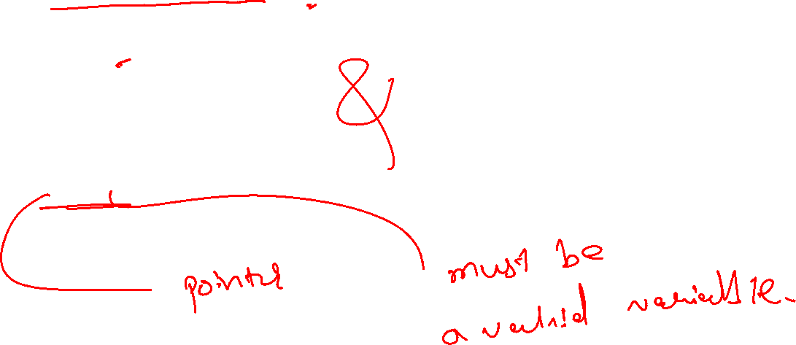
Assigning addresses to Pointers “Address of”(&) Operator
int *p
int c;
c = 5;
p = &c;

Slide 18
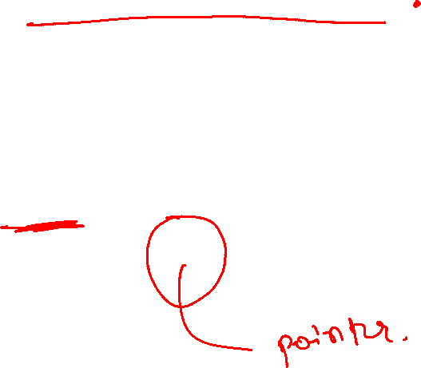
Get Value of Thing Pointed by Pointers “Value at Address”(*) Operator
int *p;
int c;
c = 5;
p = &c;
printf("%d", *p); // Output: 5

Slide 19
Functions in C

Slide 20
Functions
Codes that need to repeat
Function without any argument
Function with one or more argument
Function that returns one argument

Slide 21
Function Syntax
Function_datatype function_name(arguments)
{
return arguments_if_any
}

Slide 22

Functions to return multiple values
Using pointers to return multiple values
Pass on the address of variables function_name(&a, &b)
Write on these values

Slide 23
Global and Local Variables
C Functions demystified

Slide 24
Array Argument in Function
How to Pass an array to function in C

Slide 25
Function to Accept char array and String

Slide 26
Switch Case in C

Slide 27
switch
switch (expression)
​{
case constant1:
// statements
break;
case constant2:
// statements
break;
.
.
.
default:
// default statements
}

Slide 28
How switch case is executed
The expression is evaluated once and compared with the values of each case label.
If there is a match, the corresponding statements after the matching label are executed.
For example, if the value of the expression is equal to constant2, statements after case constant2: are executed until break is encountered.
If there is no match, the default statements are executed.

Slide 29
Preprocessor Directives
In C Coding

Slide 30
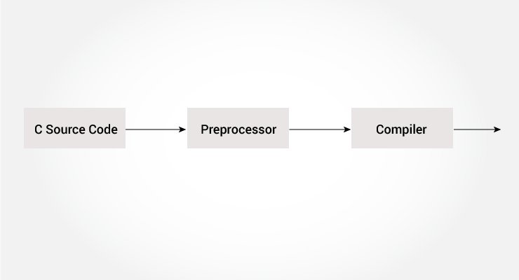
What are pre-processor directives?
Basically a text substitution tool
Begins with # symbol (remember #include ☺)

Slide 31
Example
stdio.h is a header file. The #include preprocessor directive replaces the above line with the contents of stdio.h header file.
You can also create your own header file containing function declaration and include it in your program using this preprocessor directive.
#include “my_header.h”
This file should be present in the same folder where your main c code is placed

Slide 32
#define | Substitutes a preprocessor macro.
#include | Inserts a particular header from another file.
#ifdef | Returns true if this macro is defined.
#ifndef | Returns true if this macro is not defined.
#if | Tests if a compile time condition is true.
#else | The alternative for #if.
#elif | #else and #if in one statement.
#endif | Ends preprocessor conditional.
#error | Prints error message on stderr.
#pragma | Issues special commands to the compiler, using a standardized method.

Slide 33
#define MAX_ARRAY_LENGTH 20
This directive tells the preprocessor to replace instances of MAX_ARRAY_LENGTH with 20.
We Use #define for constants to increase readability.

Slide 34
Define Macro using #define
#define message_for(a, b) printf(#a " and " #b ": We love you!\n")

